Slide 1
“Online Car Parking System”
Submitted By:
Group No: 27
Vishal Gadekar – 2042
Ashish Ingole – 2064
Hrushikesh RoKde – 2147

Slide 2
Introduction
In malls, theatres, airports car parking system is available which is managed by security staff.
There is no automated system for finding vacant parking slot, so that customers can park his vehicle easily and save time.
The Online Car Parking System allows customers to login with their own account and get vacant parking slots on the screen.

Slide 3
Aims & Objectives
To produce a web-based system that allow the admin to add parking slots, manage customer and parking details.
To ease customers by providing different functionalities to it.
To enhance security by keeping track of all details efficiently.

Slide 4
Modules
Customer :
This system will allow to create customer profile by providing customer registration functionality. System will also authenticate customer credentials if customer is already registered.
Functions:
View Vacant Parking Slots
Choose Parking Slot
Manage Booking History
View Invoice History

Slide 5
Admin
This system will allow to create admin profile by providing admin registration functionality. System will also authenticate admin credentials if customer is already registered.
Functions:
Add Parking Place & Slots
Delete Parking Slots
Manage Customer Details
Manage Parking Details
View Customer Invoices

Slide 6
Staff
This system will allow to create staff profile by providing admin registration functionality. System will also authenticate staff credentials if is already registered.
Functions:
View Customer Invoices

Slide 7
Technology Used
For Back End
Spring Boot
For Frontend End
JSP, HTML, CSS, BOOTSTRAP
Data Base
MySQL

Slide 8
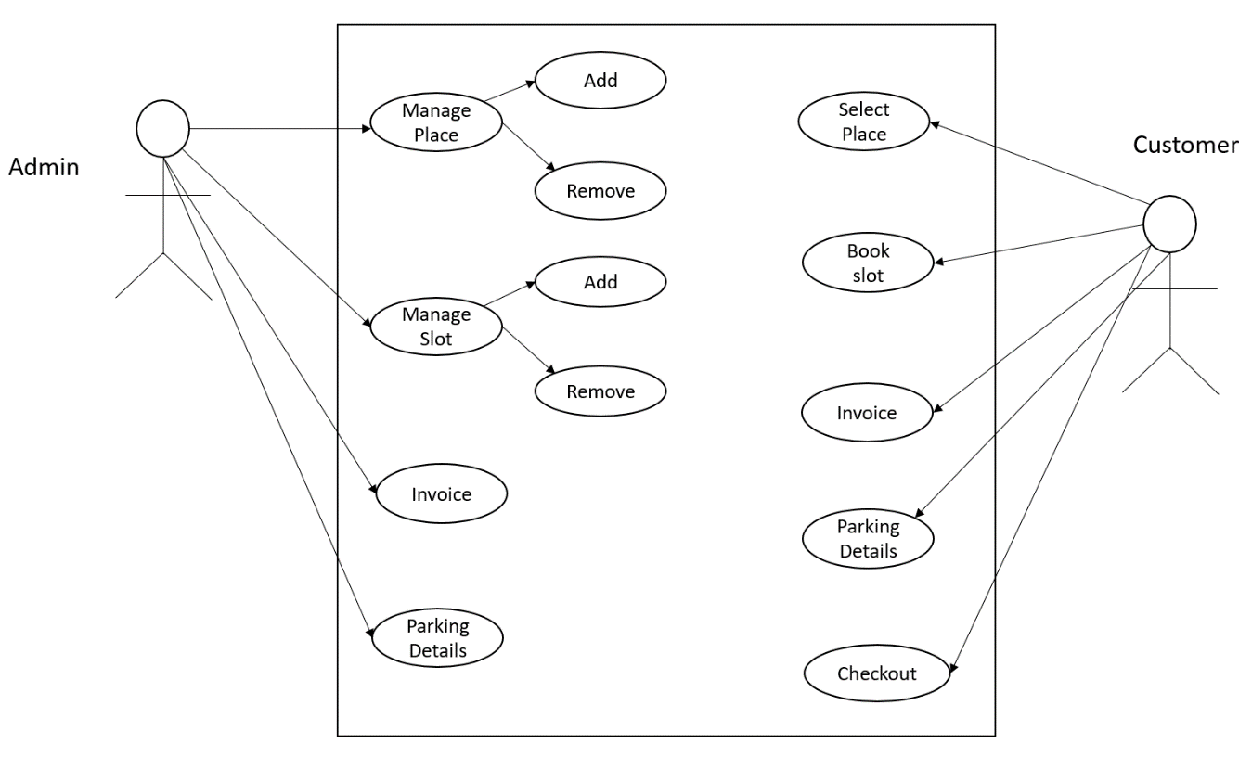
Diagrams
Use Case Diagram

Slide 9
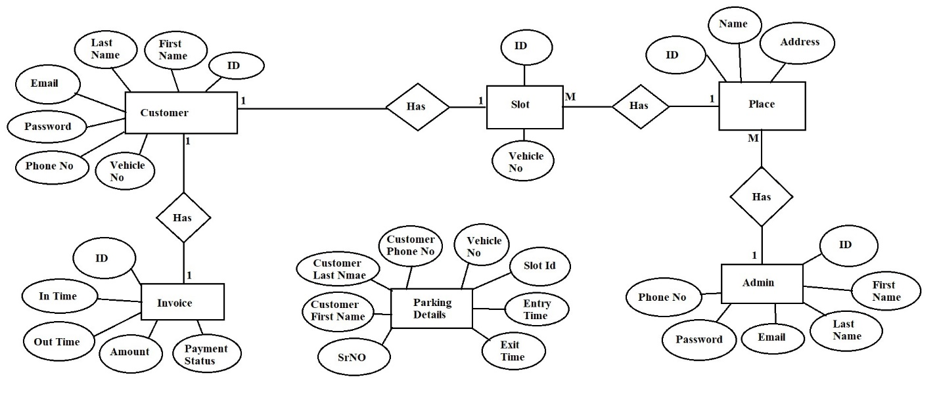
ER Diagram

Slide 10
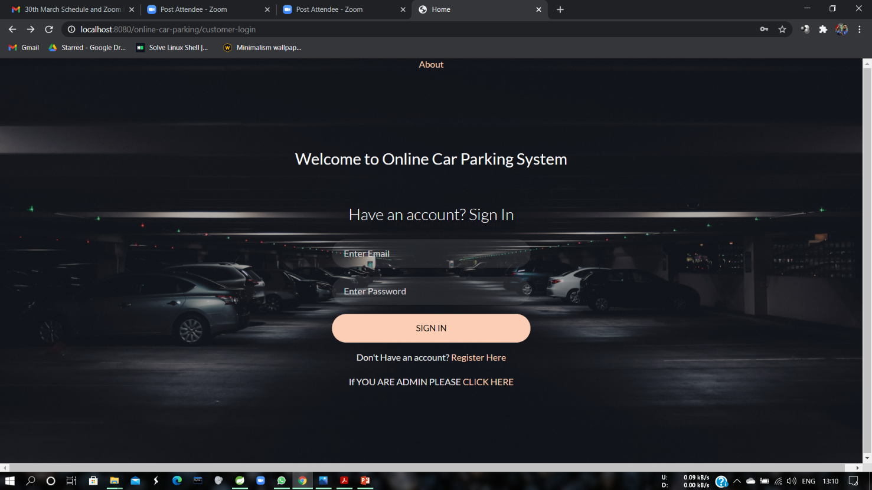
Screenshots
Customer Login

Slide 11
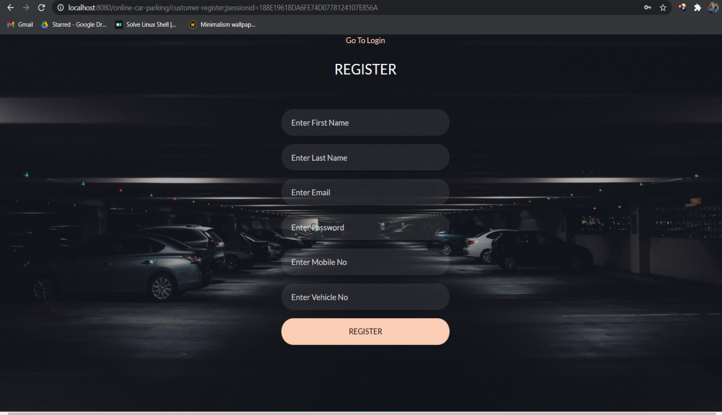
Customer Registration

Slide 12
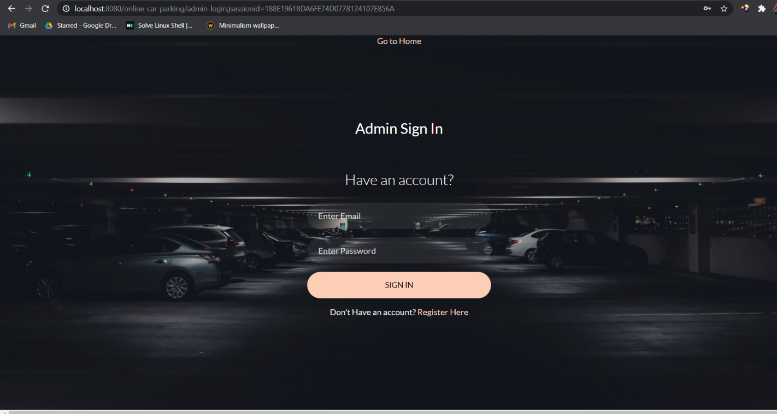
Admin Login

Slide 13
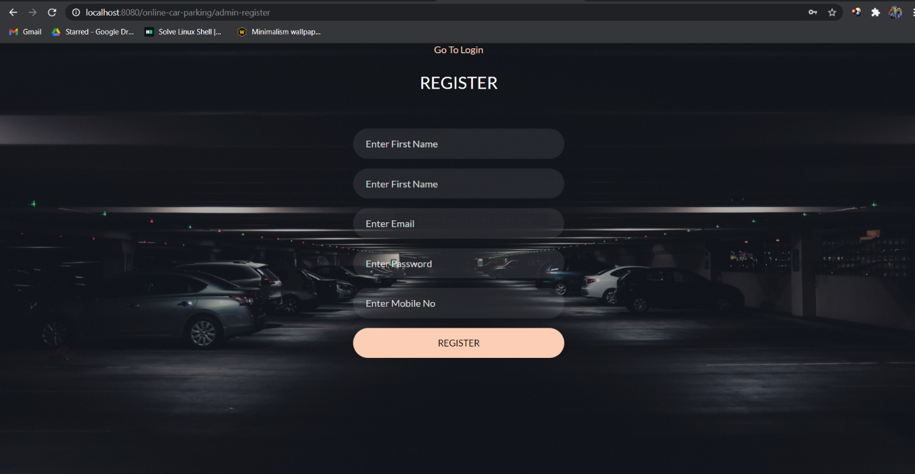
Admin Registration

Slide 14
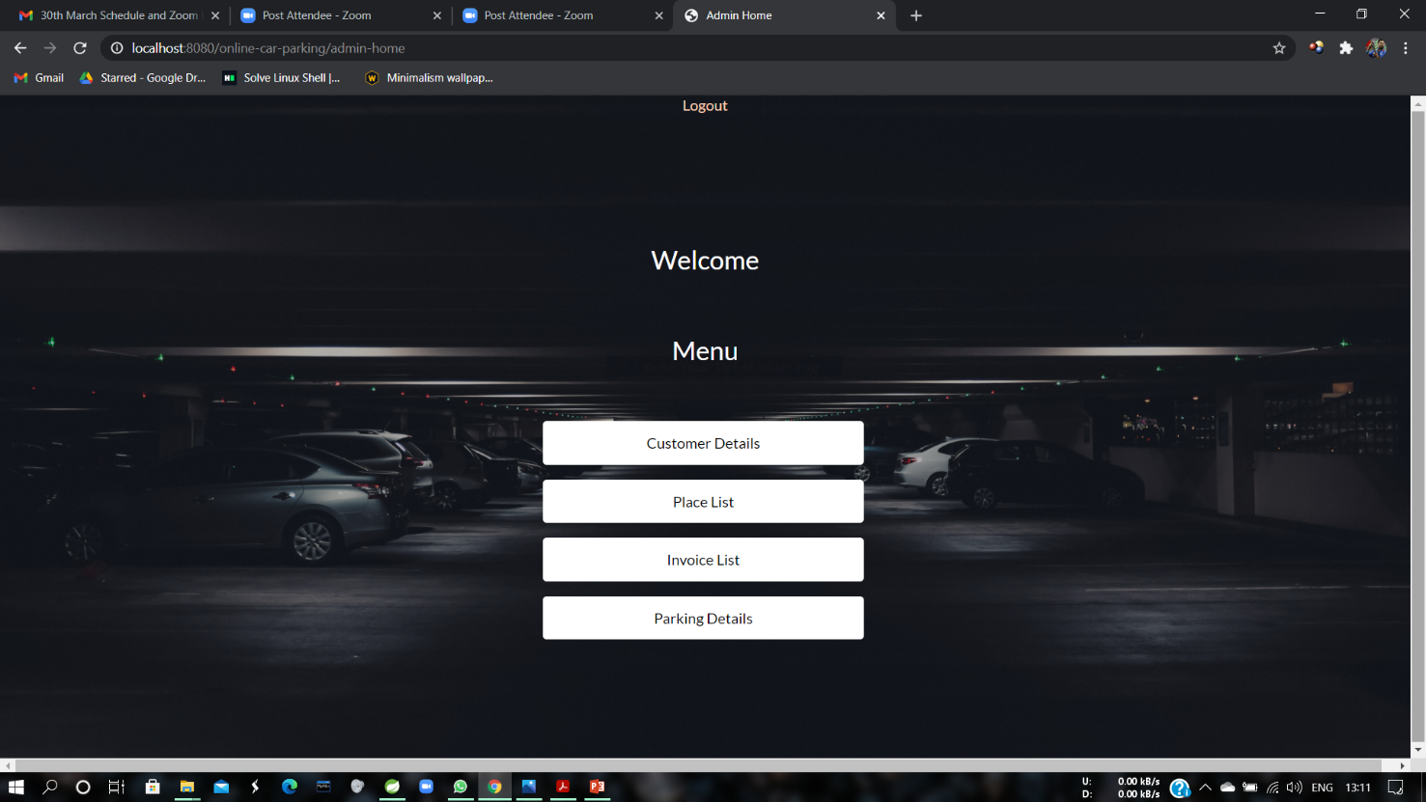
Admin Home

Slide 15
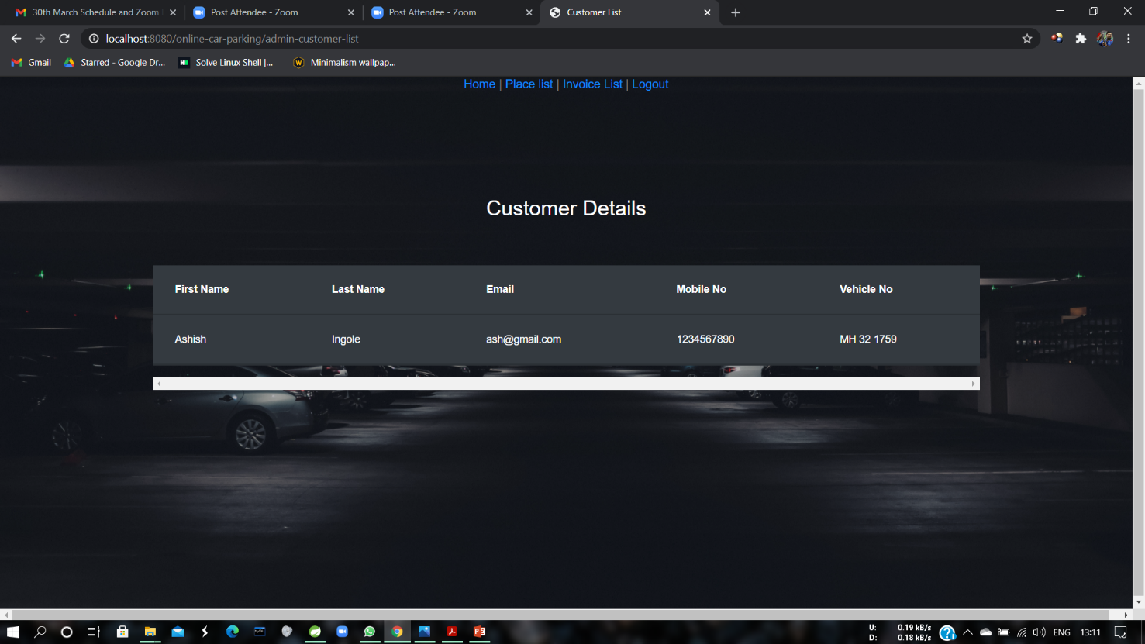
Customer Details

Slide 16
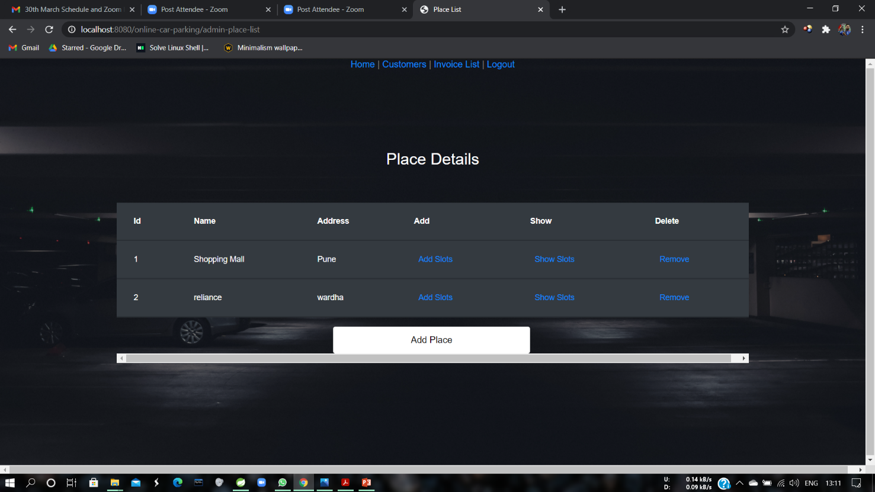
Place Details

Slide 17
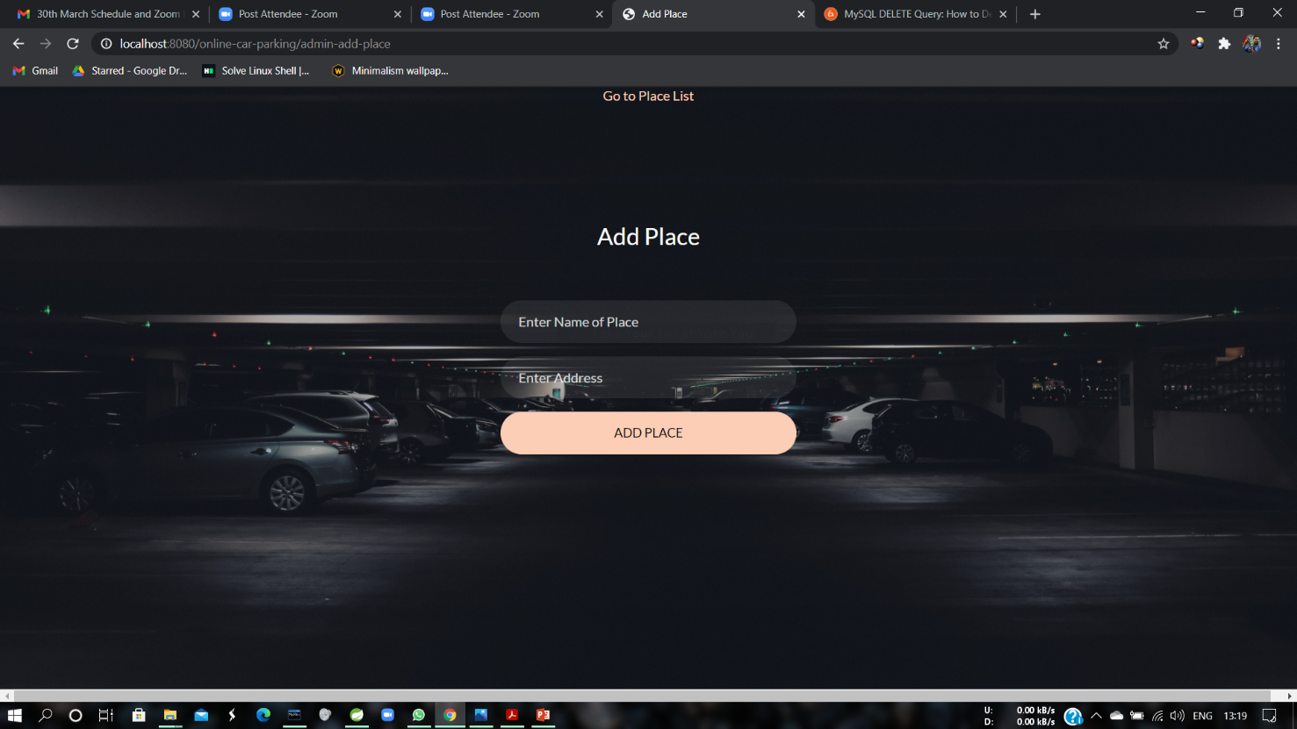
Add Place

Slide 18
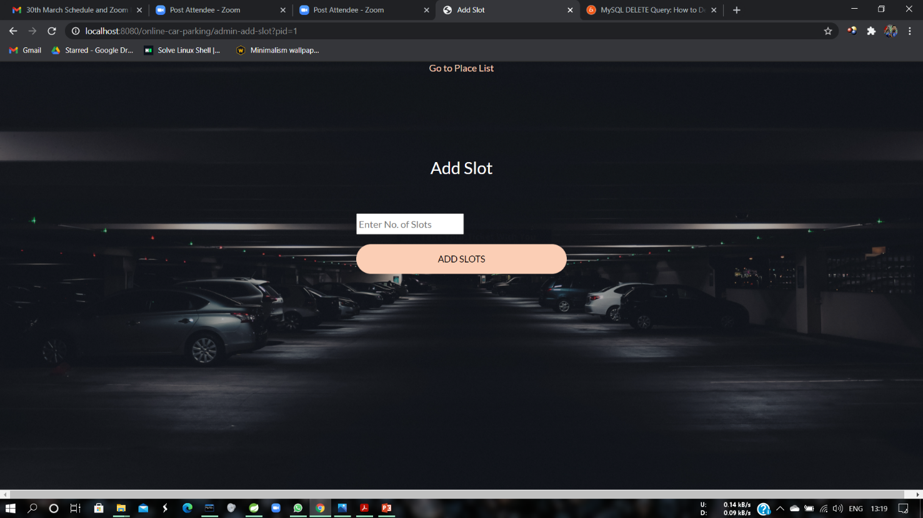
Add Slot

Slide 19
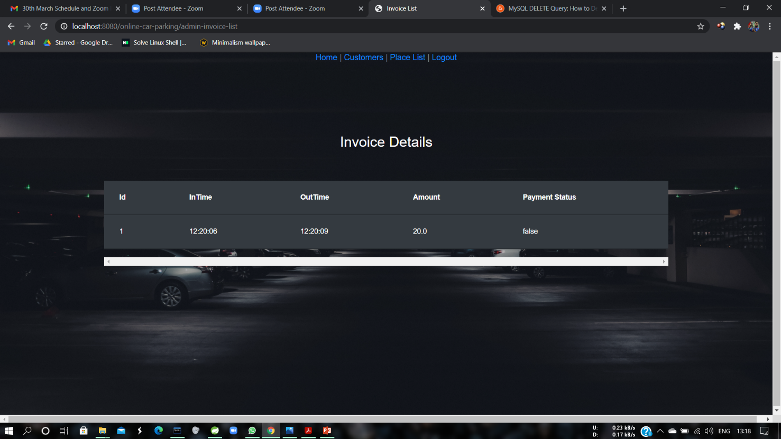
Invoice Details

Slide 20
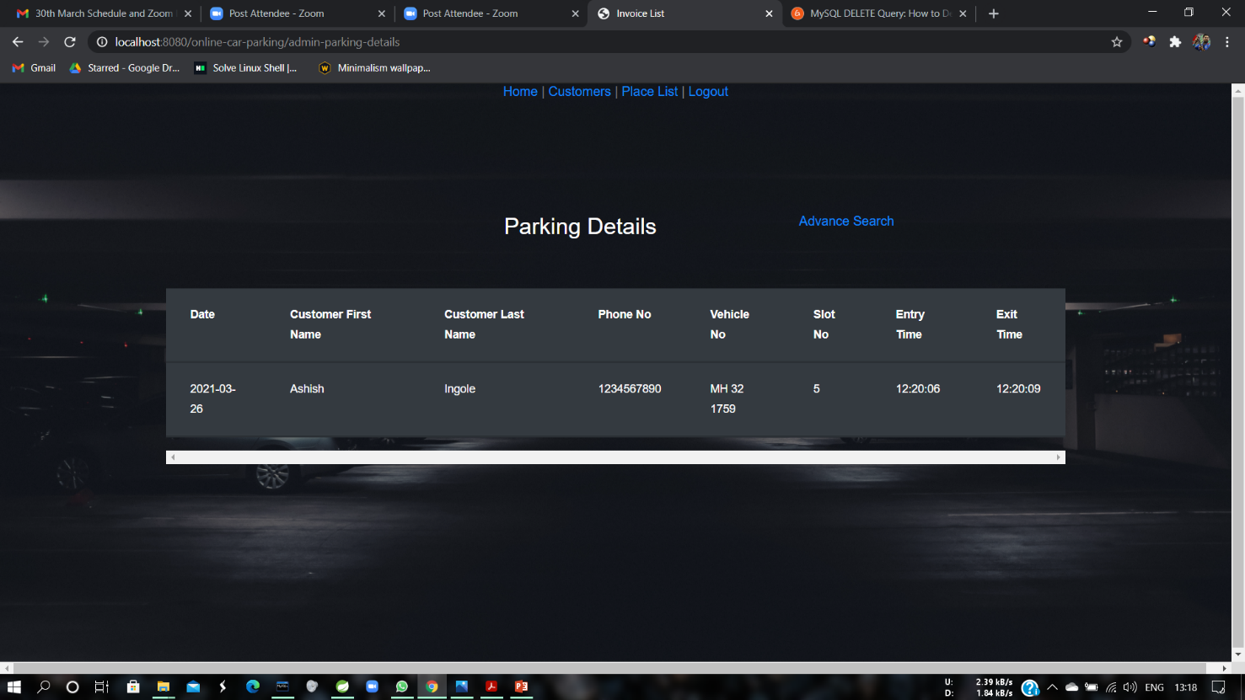
Parking Details

Slide 21
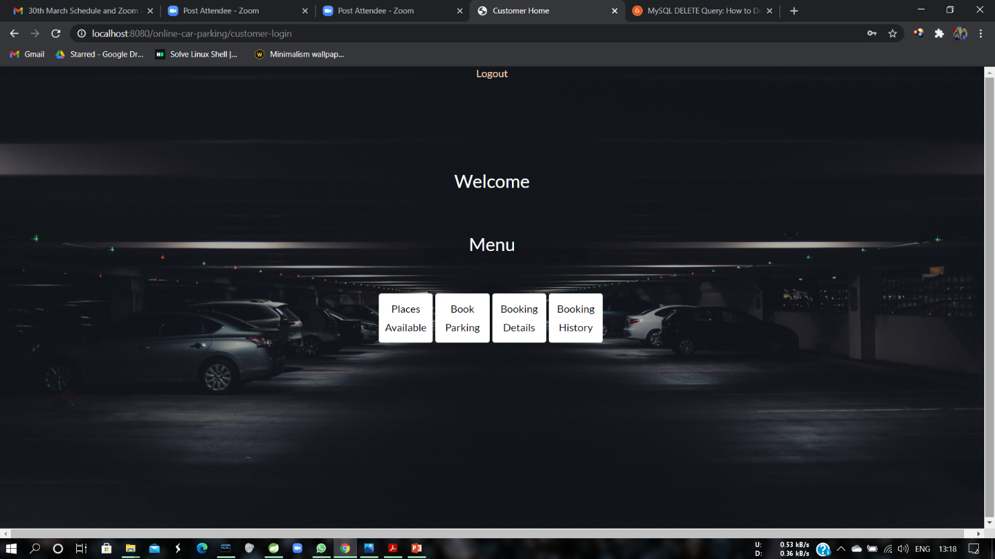
Customer Home

Slide 22
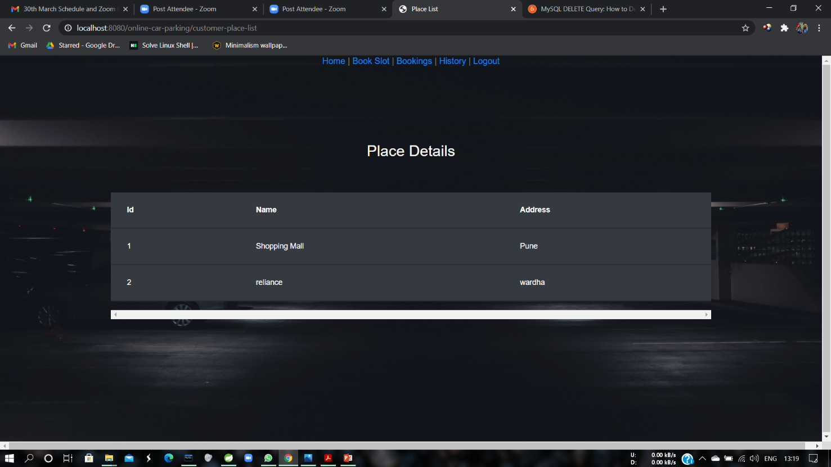
Places Available

Slide 23
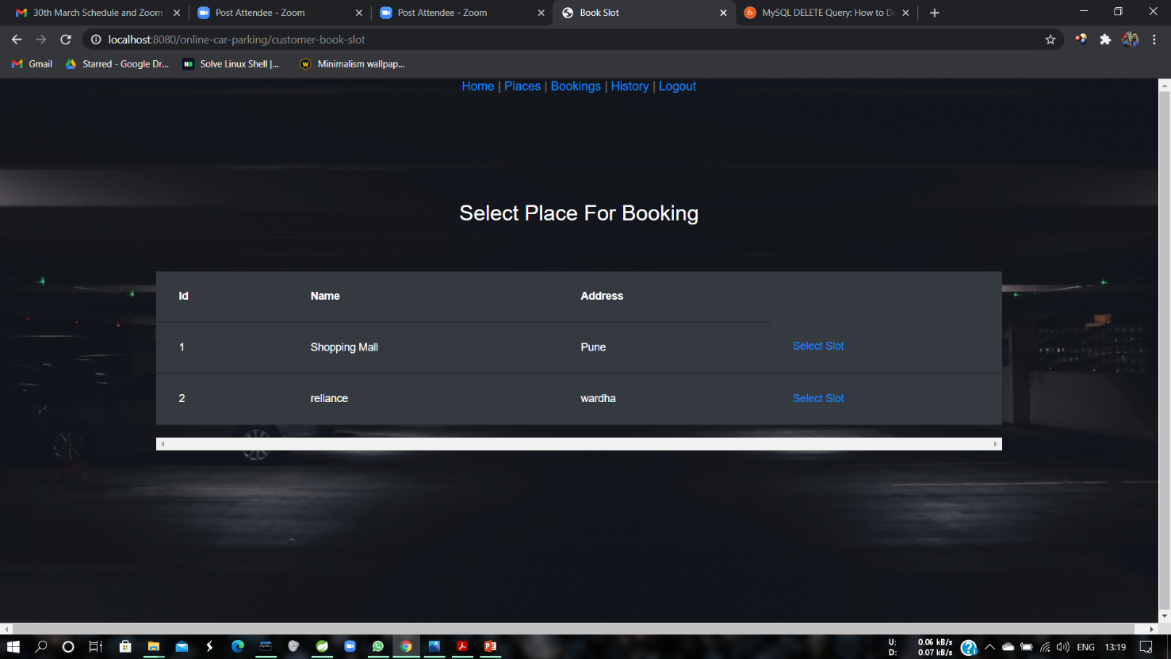
Select Place and slot

Slide 24
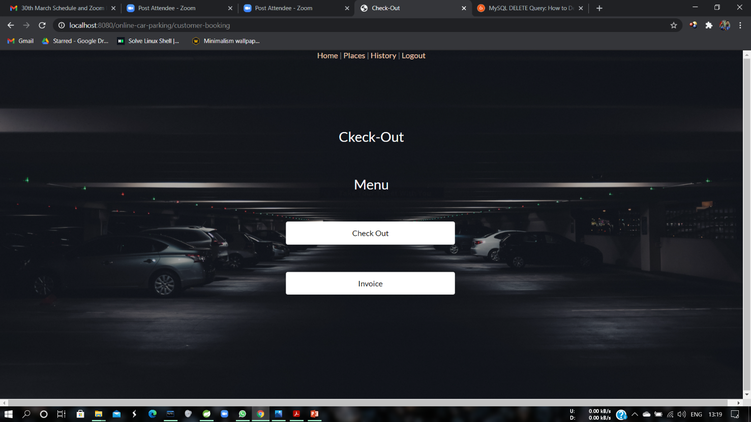
Checkout

Slide 25
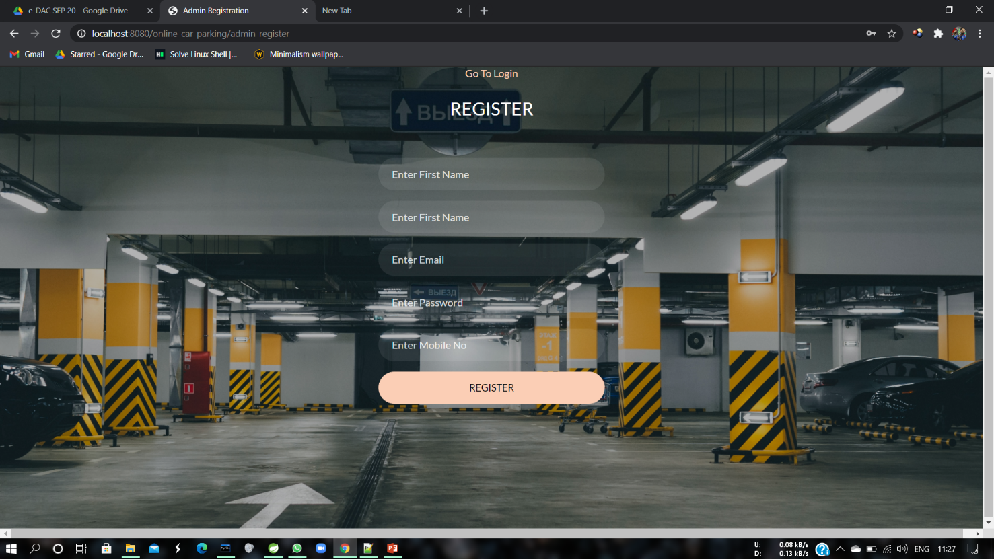
Staff Register

Slide 26
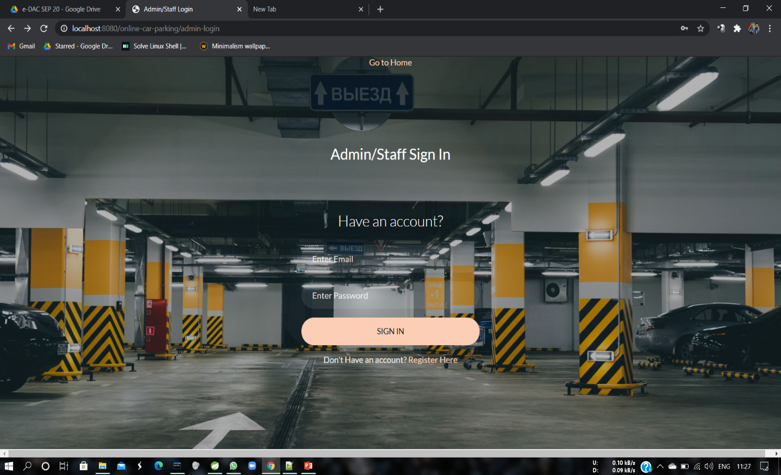
Staff Login

Slide 27
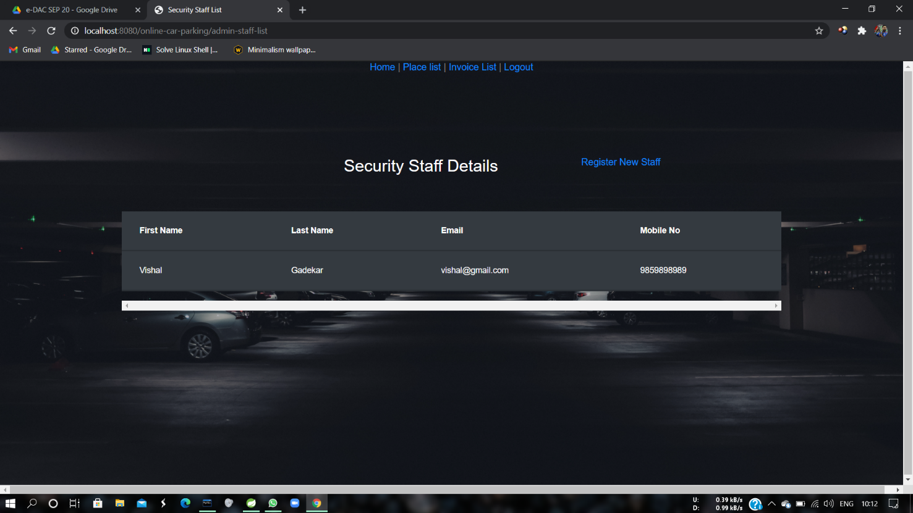
Staff Details

Slide 28
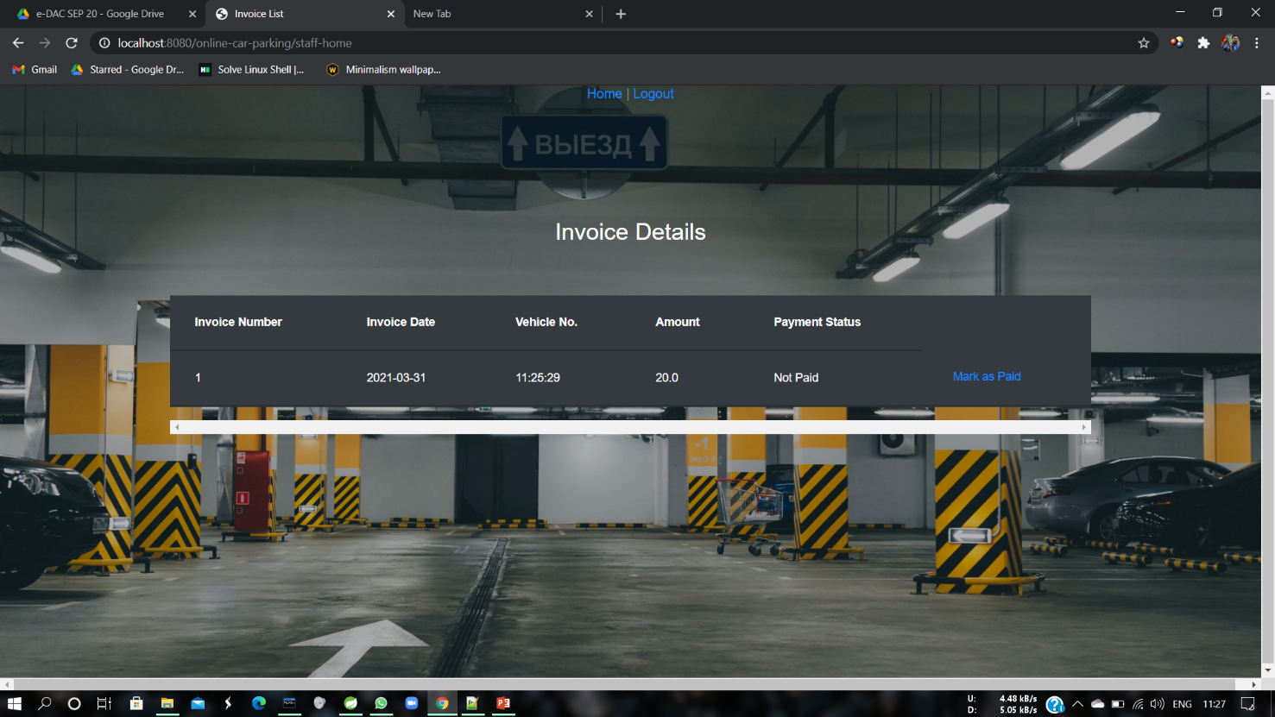
Invoice Details

Slide 29
Conclusion
Online Car Parking System puts forth the actual working of a parking.
Administration, slot management, customer management, record management, etc. are the key features of our project.
User can access services and functionalities anywhere and anytime for hassle-free parking experience.

Slide 30
Future Scope
This project can be enhanced further by adding on the spot car care services like washing, cleaning, servicing.
The software is flexible enough to be modified and implemented as per future requirements.
Message and Email alerts for various activities like check-in, check-out, invoice, etc can be added to the system.

